Slide 1
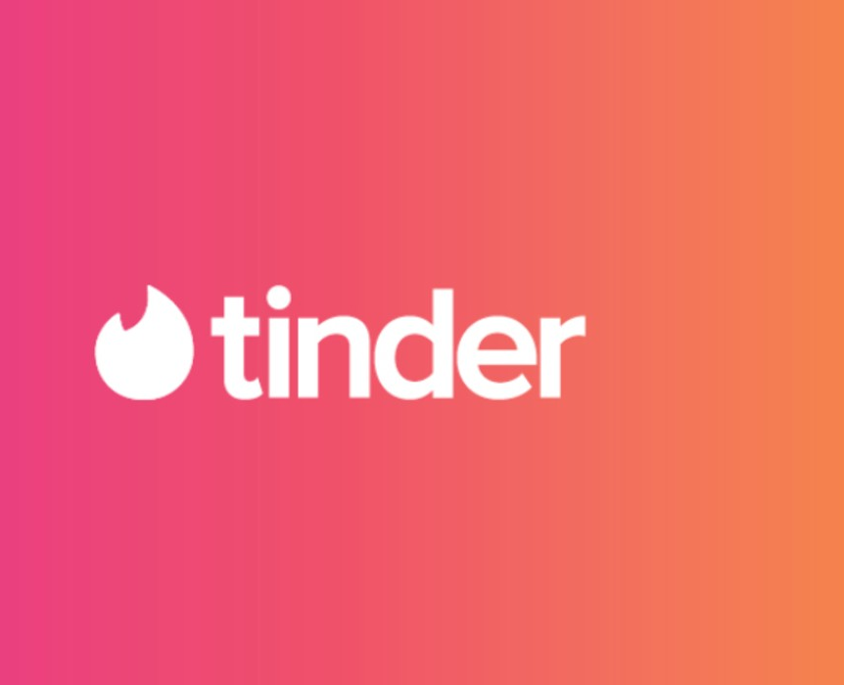
Topic Recommendation Feature

Slide 2

Problem Statement
Find topics that can create high engagement for men and women respectively for Tinder's new topic recommendation feature
Allow users to enter a string of text and generate probabilities on whether men/women will be interested in it.

Slide 3
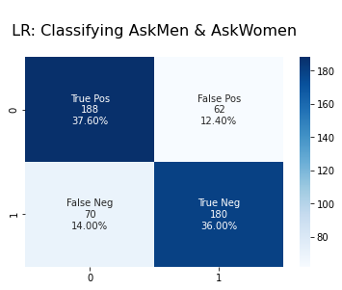
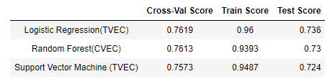
Models used to predict topics women or men are interested in
Our model is accurate in guessing which topics men and women are interested in 76.2 % of the time

Slide 4
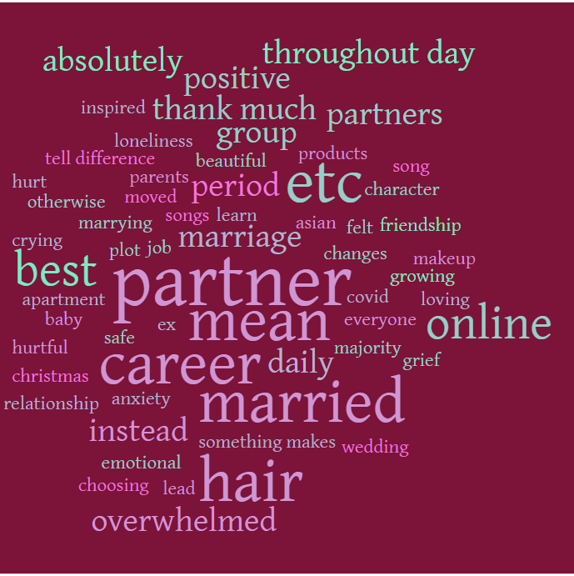
Generalized Characteristics of top posts in AskWomen
top features consist of 2 words token
Elaboration - mean (in the context of what I mean is, by _ I mean_, I_mean), experience like, look like
Relationship: marrying, married, marriage, romantic relationship, family, baby, partners, friendship
Addressing groups of people: group, society, majority, everyone
Reference to past: ex, experience like, lessons
Feelings: ever feel, loneliness, overwhelmed, hurt, hurtful, positive, emotional
Self-help - deal, coping
Success identifiers: job, career, apartment
Self-care: hair, makeup, products

Slide 5
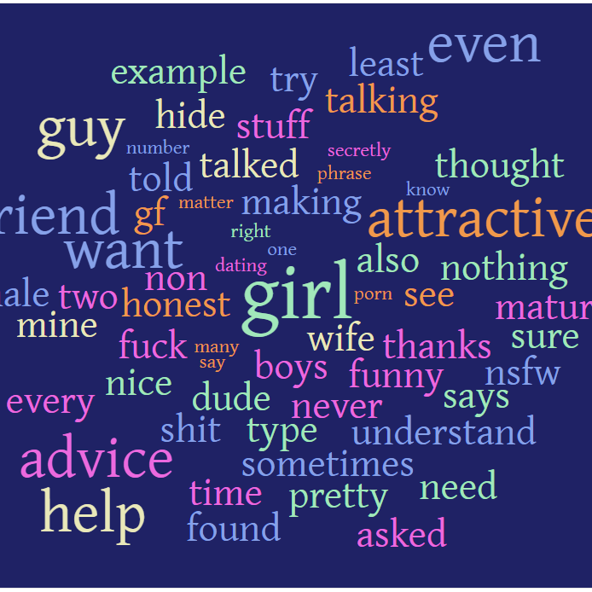
Generalized Characteristics of top posts in AskMen
top features are all 1 word
Vulgarities and explicit content: F**k, sh*t, nsfw, sex, porn
Words describing appearance and character: attractive, pretty, honest, maturity and funny, nice
Gender Identifiers: girl, girlfriend, gf, wife, guy, male, dude
Cognitive words: mine (a __ of mine, __ than mine, __to mine), need (I need, you need), want ( I want, you want)
Dating advice

Slide 6

Misclassified AskWomen posts
Probability AskMen | Probability AskWomen | Reddit Post | Actual | Predicted
11% | 89% | How can I support my partner who is grieving? | AskMen | AskWomen
14% | 86% | What’s something your SO does that makes you feel sexy? Inspired by a lovely post on r/askwomen | AskMen | AskWomen
17% | 83% | What are the things to start doing in your 20s so you don't live in regret in your 40s? | AskMen | AskWomen
18% | 82% | Men, whats the most hurtful thing you’ve overheard about yourself by accident? Edit: Wow thank you guys for everything, sending love to everyone out there 🤍 | AskMen | AskWomen
23% | 77% | As a parent, what is the most heartbreaking thing your son/daughter has done with you? | AskMen | AskWomen
23% | 77% | What’s it like dating a best friend? | AskMen | AskWomen
24% | 76% | What’s the most irritating thing you hear as a man? | AskMen | AskWomen
24% | 76% | Have you ever found yourself grieving for the person you wish you were? How did you learn to accept yourself? | AskMen | AskWomen
25% | 75% | I have a dry personality, how do I moisten it? | AskMen | AskWomen
27% | 73% | People who grew up without a father figure when did you realize that it might've had a negative impact on you? | AskMen | AskWomen
Here we take a look at posts where our model is confident in predicting that is AskWomen but are actually AskMen
Questions from women, to men
Posts that are more relevant feelings and self-help

Slide 7
Misclassified AskMen posts
Probability AskMen | Probability AskWomen | Reddit Post | Actual | Predicted
92% | 8% | How did you stop looking at yourself as a girl and start to look at yourself as woman? | AskWomen | AskMen
87% | 13% | What's a thing you want to try doing, but can't bring yourself to do it because you're afraid of how you'd be perceived? … | AskWomen | AskMen
85% | 15% | Single ladies, how are you doing? I feel like right now is specifically hard for single ladies. Being in lock down alone (or even if you are with people, alone romantically) is hard. I have found it isolating but also enlightening. \n\nHow are you doing? | AskWomen | AskMen
84% | 16% | What are you looking forward to this summer? Edit: Thanks for the silver! I'm going to try to reply to everything, but it's going to take me a bit | AskWomen | AskMen
83% | 17% | What do you want that you would never admit out loud? | AskWomen | AskMen
82% | 18% | When did you start referring to yourself and those around you as women rather than girls? …Or if you still refer to yourself as a girl rather than a woman why? | AskWomen | AskMen
81% | 19% | What home upgrades have made a big difference on your life? E.g. We raised our bed and it makes getting up so much easier because I don't have to heave myself up! | AskWomen | AskMen
Here we take a look at posts where our model is confident in predicting that is AskWomen but are actually AskMen
Questions that addresses gender
posts that has cognitive words: want
advertisements

Slide 8
Potential Topics: Matchmaking targeted to finding Women
What are your views on marriage? (long-term relationship)
What are your views on having a child? (long-term relationship)
Where do you work and you career plans (long-term relationship/success factor)
Situational questions. How do you deal with it?
Topic 1: ['life', 'someone', 'best', 'make', 'think', 'relationship', 'something’]
Topic 2: ['best', 'life', 'living', 'best friend', 'friend', 'someone', 'story’]
Topic 3: ['something', 'life', 'make', 'relationship', 'partner', 'living', 'romantic’]
Topic 4: ['thank much', 'year old', 'experiences thank', 'much sharing', 'thank much sharing', 'self esteem', 'thank much responses’]
Topic 5: ['romantic relationship', 'part relationship', 'necessarily mean', 'relationship make', 'thank everyone', 'long term', 'mental health']
Topics generated by SVD

Slide 9
Potential Topics: Matchmaking targeted to finding Men
What do many people find attractive about you? (character)
Your favourite movie (identifying sense of humour)
Multiple choice quiz about sleepwear (sex)
Topic 1: ['sex', 'one', 'thing', 'male', 'female', 'one thing', 'sexual']
Topic 2: ['love', 'find', 'often', 'dating', 'relationship', 'want', 'relationships']
Topic 3: ['one thing', 'thing wish', 'could tell', 'changed life', 'tell one', 'sent back', 'wanted know']
Topic 4: ['first time', 'even though', 'first date', 'year old', 'st birthday', 'first time life', 'time life']
Topic 5: ['red flag', 'yes know', 'someone else', 'year old', 'dated girl', 'getting know', 'thought crazy’]
Topics generated by SVD

